Slide 1
18-349: Introduction to Embedded Real-Time Systems
Lecture 10: SWI and Syscalls
Anthony Rowe
Electrical and Computer Engineering
Carnegie Mellon University

Slide 2
Administrivia
Lab 1 Due Tonight
Lab 2 Goes out tomorrow morning
Timers, SWI, Guitar Tuner
Mid-Term Exam 10/12
Practice Midterms posted on Black Board
Final Exam Slot Moved
Friday December 16th at 8:30am

Slide 3
MEMs
https://www.youtube.com/watch?v=GiG5czNvV4A

Slide 4
Last Lecture
Sensors
Actuators

Slide 5
What is an Actuator?
Something that converts energy into motion (or applies a force)
Electrical
Motors, Solenoid, Piezoelectric, Electroactive polymers, Speakers, heating coil
Chemical
Animal Muscle, Combustion Engine
Hydraulics
Fluid Pressure

Slide 6
Motor Controller
Entire Lecture about this later…
Encoder
Feedback
Controller (PID)
Sensing
Weak Signal
Motor
H-Bridge
Output
Amplified Signal

Slide 7
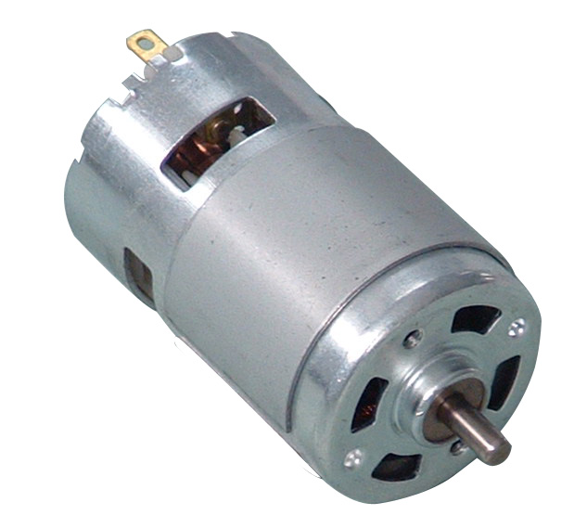
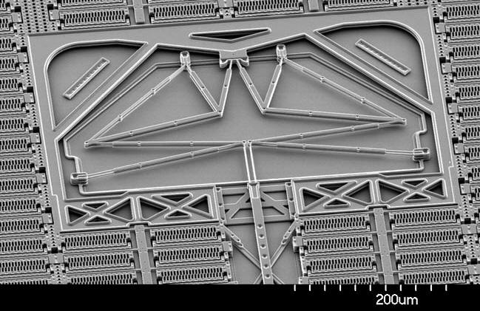
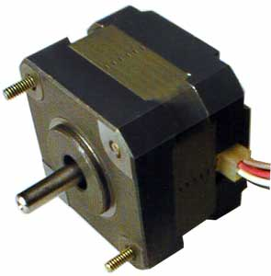
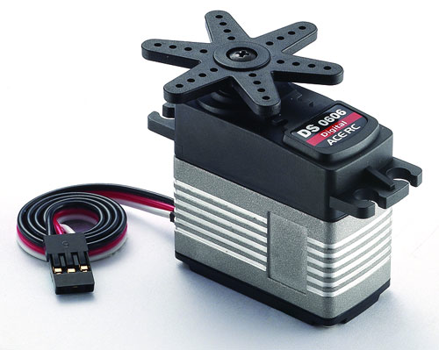
Motors
AC / DC Motor
Magnetic, Electrostatic
Stepper Motor
Brushless motor that moves discrete steps
Can be very accurate without sensing
Servo Motor
Motor with built-in sensing to hold set positions
Usually does not rotate 360 degrees

Slide 8
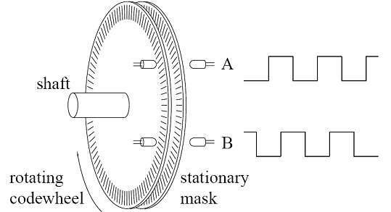
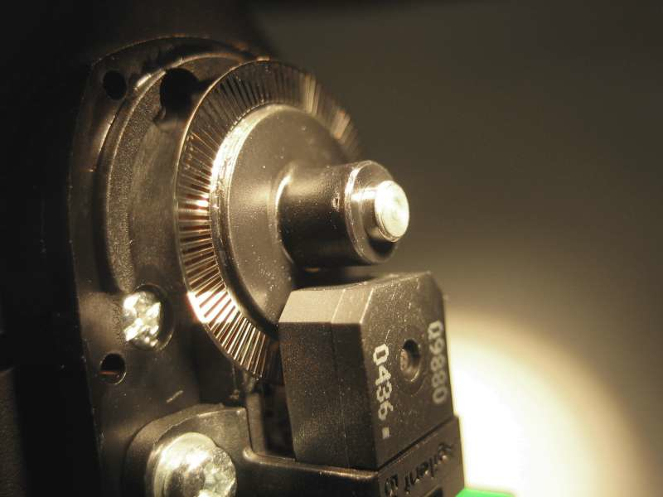
Encoder
00
10
01
11
Grey Code State Machine

Slide 9
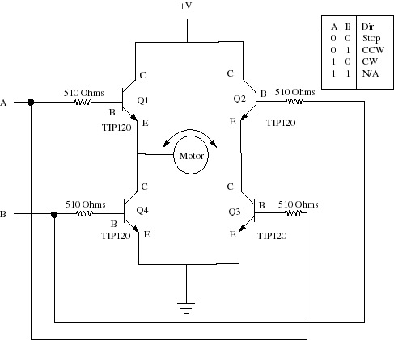
H-Bridge Circuit

Slide 10
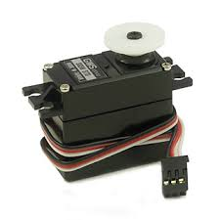
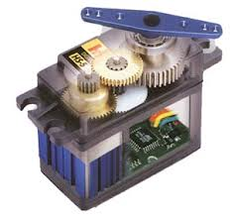
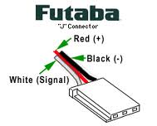
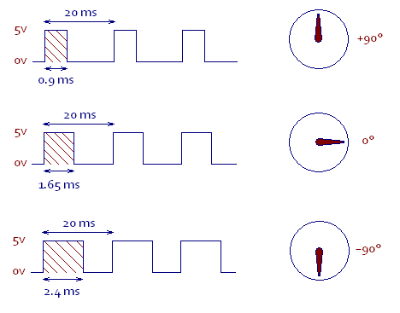
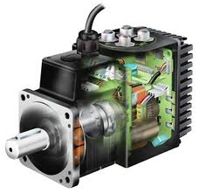
Servo

Slide 11

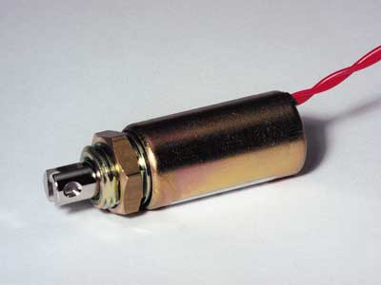
Solenoid
Magnet pulling on spring-loaded linear actuator
Used in door locks and valves

Slide 12
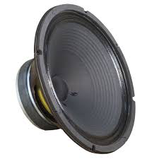
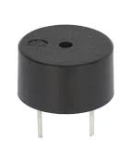
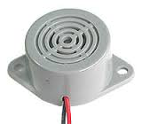
Audio
Speaker
Creates arbitrary sound
Buzzer
Creates a single or relatively narrow frequency of sound
Often the oscillator is included

Slide 13
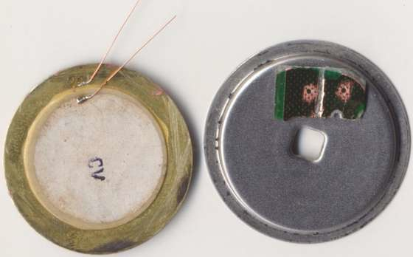
Piezoelectric
Piezoelectric material flexes when a voltage is applied (conversely it generates a voltage when flexed)
Often used in low-profile buzzers

Slide 14
Outline
Exception Handling on the ARM Processor
What is a SoftWare Interrupt (SWI)?
What are SWIs useful for?
What happens on a SWI?
What happens on SWI completion?
How to install a SWI handler

Slide 15
Exceptions vs. Interrupts (Recap)
The terms exception and interrupt are often confused
Exception usually refers to an internal CPU event such as
floating point overflow
MMU fault (e.g., page fault)
trap (SWI)
Interrupt usually refers to an external I/O event such as
I/O device request
In the ARM architecture manuals, the two terms are mixed together and are used interchangeably
For this course, exceptions and interrupts will mean the same thing

Slide 16
Exception Handling (Recap)
Exception Handler
Most exceptions have an associated software exception handler that executes when that particular exception occurs
Where is this exception handler located?
Vector table
Reserved area of 32 bytes at the end of the memory map (starting at address 0x0)
One word of space for each exception type
Contains a Branch or Load PC instruction for the exception handler
Exception modes and registers
Handling exceptions changes program from user to non-user mode
Each exception handler has access to its own set of registers
Its own r13 (stack pointer)
Its own r14 (link register)
Its own spsr (Saved Program Status Register)
Exception handlers must save (restore) other register on entry (exit)

Slide 17
Exception Handling (Recap)
When an exception occurs, the ARM:
Copies cpsr into spsr_<mode>
Sets appropriate cpsr bits
Change to ARM state
Change to exception mode
Disable IRQ and FIQ (if appropriate)
Stores the pc-4 in lr_<mode>
Sets pc to vector address
To return, exception handler needs to:
Restore cpsr from spsr_<mode>
Restore pc from lr_<mode>
0x1C
FIQ
0x18
IRQ
0x14
(Reserved)
0x10
Data Abort
0x0C
Prefetch Abort
0x08
Software Interrupt
0x04
Undefined Instruction
0x00
Reset
Vector Table

Slide 18
System Calls (1-2)
Systems Calls are ways by which programs running in user mode request services from an operating system
Programs running in user mode typically have restrictions on their ability to directly interact with system resources
To protect system resources from errant/malicious programs

Slide 19
System Calls (2-2)
Typical sequence by which user mode programs request resources from an OS maybe
Programs invoke system calls to request/interact with system resources (example: program may use the open system call to request the OS to open a file on its behalf)
OS verifies whether the resource can be safely allocated to the program or if the program has access to the requested resource (in the previous example, the OS verifies whether the user program making the open system call has read/write permissions to the file, the file exists…)
If the requesting program does not have access to the resource or a resource cannot be safely allocated to the program, an error is returned to the program invoking the system call otherwise OS performs the requested service and returns the result (in the previous example of open system call, the OS will return a file descriptor to the file)
How are system calls represented differently from function calls?

Slide 20
What are SWIs?
SoftWare Interrupt (SWI) is an instruction provided by the ARM Instruction Set
SWI instruction causes an exception
Executes in the privileged mode
SWI provides a way for a program running in User mode to request a service that can only be accessed in a privileged mode
Typically, used by applications to call operating system routines

Slide 21
SWIs or Function Calls?
SWIs are similar to a sub-routine call because
Parameters and return values can be passed through registers
Differs from a sub-routine call because the ARM processor
Stashes away user mode CPSR
Switches to supervisor mode (if not already in supervisor mode)
Starts executing from a specific location (always 0x08)

Slide 22

SWI in Action
Application Program
fread()
Standard C Library
swi
Operating System
Hardware Device
Driver
Hardware
Device

Slide 23
SWI Instruction Format
Example: SWI 0x18
The number identifies the handler to be called
Example 0x18 could refer to a SWI handler that reads key input whereas 0x19 could refer to a SWI handler that outputs a char etc. …
The last 24-bits of the SWI instruction contain the SWI number
31
28
27
24
23
0
cond
1 1 1 1
24-bit SWI number
SWI number

Slide 24
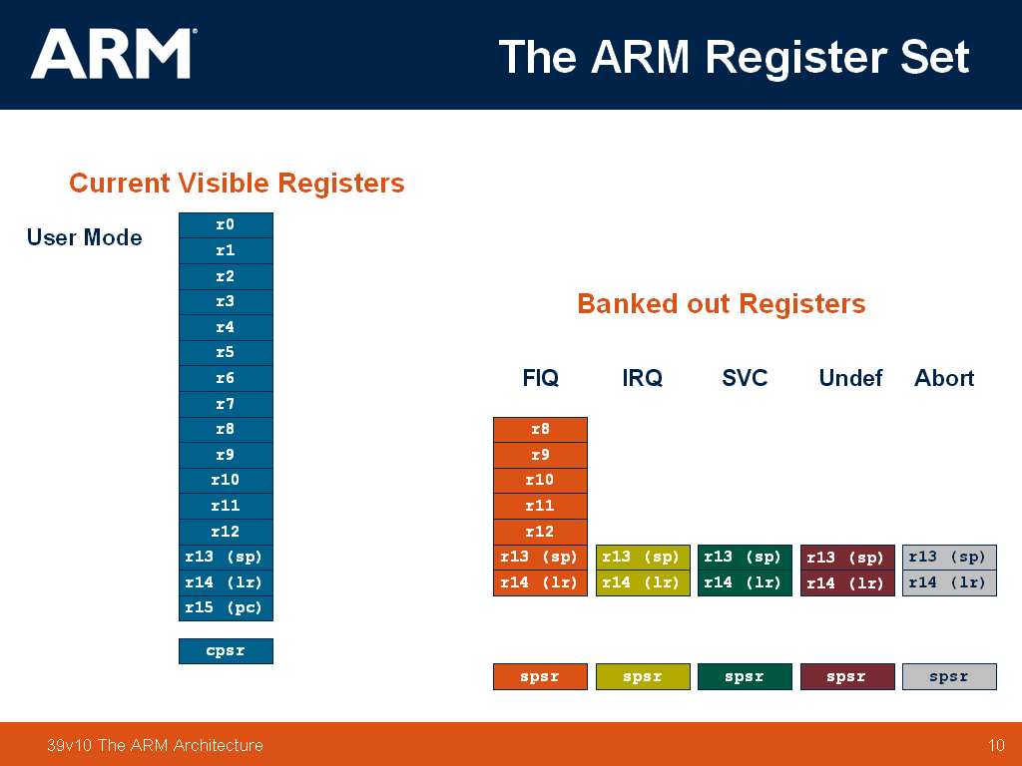
SWI Handling
Assume initially in User mode
When the processor executes the SWI instruction, the ARM processor
Copies cpsr into spsr_svc
Sets appropriate cpsr mode bits to 10011 (svc mode)
Disables IRQs
Stores return address (pc – 4) in lr_svc
Sets pc to vector address 0x08
To return, exception handler needs to:
Restore cpsr from spsr_svc (cpsr now has mode bits 10000 = usr mode)
Restore pc from lr_svc
In privileged modes, a single instruction can be used to cause the SPSR for the current mode to be copied into CPSR while copying lr into pc
MOVS pc, lr
on SWI
back to
user program

Slide 25
What Happens on a SWI? (1)
The ARM architecture defines a Vector Table indexed by exception type
On SWI
lr_svc b pc-4
spsr_svc b cpsr
cpsr(mode bits) b 10011 (supervisor mode, no IRQ)
pc b 0x08 (address of SWI vector)
Reset Handler
Undef Handler
SWI Handler
Prefetch Handler
Data Handler
Reserved
IRQ Handler
FIQ Handler
USER Program
0x00
0x04
0x08
0x0c
0x10
0x14
0x18
0x1c
Vector Table
starting at 0x00 in memory
ADD r0,r0,r1
SWI 0x10
SUB r2,r2,r0
1

Slide 26
What Happens on a SWI? (2)
Not enough space in the table (only one instruction per entry) to hold all of the code for the SWI handler function
This one instruction must transfer control to appropriate SWI Handler
Vector Table
starting at 0x00 in memory
to Reset Handler
to Undef Handler
to SWI Handler
to Prefetch Handler
to Data Handler
Reserved
to IRQ Handler
to FIQ Handler
USER Program
0x00
0x04
0x08
0x0c
0x10
0x14
0x18
0x1c
ADD r0,r0,r1
SWI 0x10
SUB r2,r2,r0
SWI Handler
1
2

Slide 27
“Vectoring” SWI to its Handler
Option #1: Use a branch instruction (limited range because branch offset must be within 32 MB of branch instruction)
Vector Table
starting at 0x00 in memory
USER Program
B Reset_Handler
B Undef_Handler
B S_Handler
B D_Handler
B Prefetch_Handler
B Somewhere
B IRQ_Handler
First instruction of FIQ
SWI Handler
(S_Handler)
0x00
0x04
0x08
0x0c
0x10
0x14
0x18
0x1c
ADD r0,r0,r1
SWI 0x10
SUB r2,r2,r0
2

Slide 28
“Vectoring” SWI to its Handler
Option #2: Load the address of the actual handler into the pc using LDR instruction
A memory location (call it softvec) stores the address of the SWI handler (S_Handler)
Use LDR instruction to load pc with contents of softvec
Compute the offset (#offset) of softvec from SWI vector and use LDR pc, [pc, #offset] to load the address of S_Handler into pc
Offset for LDR instruction is represented by 12 bits; hence softvec should be a max of 4K away from 0x08 , but address stored in softvec can be a 32-bit address

Slide 29
“Vectoring” SWI to its Handler
Vector Table
starting at 0x00 in memory
SWI Handler
(S_Handler)
USER Program
0x00
0x04
0x08
0x0c
0x10
0x14
0x18
0x1c
LDR pc, [pc, 0x100]
LDR pc, [pc, 0x100]
LDR pc, [pc, 0x100]
LDR pc, [pc, 0x100]
LDR pc, [pc, 0x100]
LDR pc, [pc, 0x100]
LDR pc, [pc, 0x100]
LDR pc, [pc, 0x100]
ADD r0,r0,r1
SWI 0x10
SUB r2,r2,r0
2
“Jump” Table
0x108
0x10c
0x110
0x114
...
&S_Handler
&U_Handler
&A_Handler
&P_Handler
...
softvec

Slide 30
On SWI completion
When the handler is done, it returns to the USER program ­­ at the instruction following the SWI
MOVS restores the original CPSR as well as changing pc
Vector Table
starting at 0x00 in memory
SWI Handler
(S_Handler)
USER Program
0x00
0x04
0x08
0x0c
0x10
0x14
0x18
0x1c
LDR pc, [pc, 0x100]
LDR pc, [pc, 0x100]
LDR pc, [pc, 0x100]
LDR pc, [pc, 0x100]
LDR pc, [pc, 0x100]
LDR pc, [pc, 0x100]
LDR pc, [pc, 0x100]
LDR pc, [pc, 0x100]
ADD r0,r0,r1
SWI 0x10
SUB r2,r2,r0
2
By convention, the ARM PC is always 8 bytes (two instructions) ahead of the current instruction that finishes. So if the instruction at 0x08 is executing, then the PC would already have been 0x10. Hence, S_handler is at 0x110.
“Jump” Table
3
MOVS pc, lr
0x108
0x10c
0x110
0x114
...
&A_Handler
&U_Handler
&S_Handler
&P_Handler
...
softvec

Slide 31
Which syscall to execute? (1)
ARM processor ignores the last 24-bits of the SWI instruction (containing the SWI number)
Problem: All SWIs go to 0x08 regardless of the number that you put after the SWI instruction
How do you find out which SWI to execute if they all end up at the same address?
31
28
27
24
23
0
cond
1 1 1 1
24-bit SWI number
SWI number holds information about the syscall to execute

Slide 32
Which syscall to execute? (2)
How would we extract the SWI number, if we knew that the 32-bit representation of the instruction (SWI 0x18) was stored in a register (say r0)?
If register r0 somehow stored the 32-bit representation of the instruction (SWI 0x18) how would you extract the SWI number?
Basically, you want to extract the last 24 bits of the register r0
Use bit-clearing (BIC) to zero out the 8 MSBs
BIC r0, r0, #0xff000000
This effectively sets r0 to the result of (r0 AND ~0xff000000)

Slide 33
Which syscall to execute? (3)
When you are at S_Handler in svc mode
Is it possible for you to find out where you came from in user mode?
Can you exploit this information to find out which SWI you should execute?
USER Program
Vector Table
starting at 0x00 in memory
SWI Handler
(S_Handler)
ADD r0,r0,r1
SWI 0x18
SUB r2,r2,r0
0x00
0x04
0x08
0x0c
0x10
0x14
0x18
0x1c
to R_Handler
to U_Handler
to S_Handler
to P_Handler
to D_Handler
...
to I_Handler
to F_Handler
(Reset
(Undef instr.)
(SWI)
(Prefetch abort)
(Data abort)
(Reserved)
(IRQ)
(FIQ)
A single SWI
Handler must
serve as clearing
house for different
SWIs
MOVS pc, lr

Slide 34
Which syscall to execute? (4)
The link register holds the key
Take a look at lr_svc
Holds information about the instruction in user space that immediately follows the SWI (done by the processor at the time that it switches into svc mode)
If you step back 4 bytes from lr_svc, what do you get?
LDR r0,[lr,#­4]
r0 stores the 32-bit encoding of the SWI instruction, in this case, SWI 0x18
Last 24 bits (the comment field) contain the SWI number
Extract the SWI number now by clearing out everything but the last 24 bits
BIC r0,r0,#0xff000000

Slide 35
Which syscall to execute? (3)
USER Program
Vector Table
starting at 0x00 in memory
SWI Handler
(S_Handler)
ADD r0,r0,r1
SWI 0x18
SUB r2,r2,r0
0x00
0x04
0x08
0x0c
0x10
0x14
0x18
0x1c
to R_Handler
to U_Handler
to S_Handler
to P_Handler
to D_Handler
...
to I_Handler
to F_Handler
(Reset
(Undef instr.)
(SWI)
(Prefetch abort)
(Data abort)
(Reserved)
(IRQ)
(FIQ)
LDR r0,[lr,#­4]
BIC r0,r0,#0xff000000
; r0 holds SWI Number
MOVS pc, lr

Slide 36
PC Offset
On SWI
lr_svc b pc-4
spsr_svc b cpsr
cpsr(mode bits) b 10011 (supervisor mode, no IRQ)
pc b 0x08
USER Program
ADD r0,r0,r1
SWI 0x18
SUB r2,r2,r0
…
Executing (PC-8)
LR (PC-4)
PC (+2 inst)
USER Program
Vector Table
starting at 0x00 in memory
SWI Handler
(S_Handler)
ADD r0,r0,r1
SWI 0x18
SUB r2,r2,r0
0x00
0x04
0x08
0x0c
0x10
0x14
0x18
0x1c
to R_Handler
to U_Handler
to S_Handler
to P_Handler
to D_Handler
...
to I_Handler
to F_Handler
(Reset
(Undef instr.)
(SWI)
(Prefetch abort)
(Data abort)
(Reserved)
(IRQ)
(FIQ)
LDR r0,[lr,#­4]
BIC r0,r0,#0xff000000
; r0 holds SWI Number
MOVS pc, lr

Slide 37
Use The SWI # to Jump to “Service Routine”
SWI Handler
(S_Handler)
Key Insight – need access to general purpose register (lr in this case)
Initial part of the SWI Handler has to be written in assembly
Exit also in assembly
Once we capture the SWI number and store it in r0
Call a C function from the assembly code to service the specific SWI
Easier to write SWI handler in C rather than assembly
Remember ATPCS conventions
r0 contains the first argument of a function call
Caution:
In S_Handler the address of the return instruction (to user program) is stored in lr_svc
BL call will overwrite the value of lr_svc
Need to save lr_svc in S_Handler before using BL
…
…
LDR r0,[lr,#­4]
BIC r0,r0,#0xff000000
BL C_SWI_Handler
…
MOVS pc, lr
C_SWI_Handler
…
void C_SWI_Handler(int swi_num, …)
{
switch(swi_num) {
case 0x00: service_SWI1();
case 0x01: service_SWI2();
case 0x02: service_SWI3();
…
}
}

Slide 38
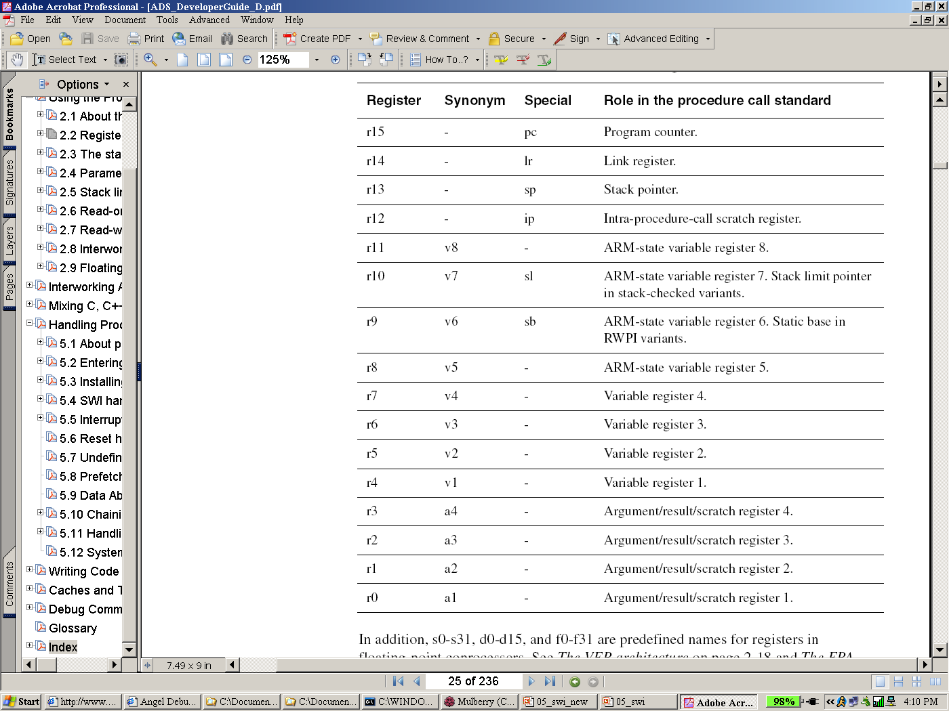
ATPCS Conventions (Recap)

Slide 39
SWI Handler
S_Handler
STMFD sp!, {r0­r12, lr} ;store user's gp registers and lr_svc
MOV r1, sp ;r1 now contains pointer to parameters on stack
LDR r0, [lr, #­4] ; extract the SWI number
BIC r0,r0,#0xff000000 ; get SWI # in r0 by bit-masking
BL C_SWI_handler ; go to handler (see next slide)
LDMFD sp!, {r0­r12, lr} ; unstack user's registers and lr_svc
MOVS pc, lr ; return from handler

Slide 40
C_SWI_Handler
lr_svc
void C_SWI_handler(unsigned swi_num, unsigned *regs)
{
switch (swi_num) {
case 0: /* SWI number 0 code */ break;
case 1: /* SWI number 1 code */ break;
...
case XXX: /* SWI number XXX code */ break;
default:
} /* end switch */
} /* end C_SWI_handler() */
regs[12]
r12
r11
r10
r9
r8
r7
r6
r5
r4
r3
r2
r1
regs[0] (also *regs)
r0

Slide 41
Reentrant Exception Handlers
Reentrant programming – used to describe code which can have concurrent invocations which should ideally not interfere with each other
What happens if you want to call another SWI from your SWI handler?
When an SWI occurs, the ARM
Sets appropriate CPSR mode bits to 10011 (svc mode)
Copies CPSR into spsr_svc
Stores return address (pc – 4) in lr_svc
Sets pc to vector address 0x08
Need to save certain registers (that do not need to be saved otherwise)
Do you see any issues here?

Slide 42
Program Status Register Instructions
Two instructions to directly control a Program Status Register
MRS
Transfers the contents of either the cpsr or the spsr into a register
MSR
Transfers the contents of a register into the cpsr or the spsr
PRE cpsr = nzcvqIFt_SVC
MRS r1, cpsr
BIC r1, r1, #0x080
MSR cpsr, r1
POST cpsr = nzcvqiFt_SVC
Notes:
How to enable IRQ interrupts
Note this happens in SVC mode. In user mode, you can read all cpsr bits, but you can only update the condition flag field
BIC Disables the IRQ bit since you serviced it

Slide 43
A Reentrant SWI Handler for Lab2
import C_SWI_Handler
export S_Handler
S_Handler
SUB sp, sp, #4 ; leave room on stack for SPSR
STMFD sp!, {r0­r12, lr} ; store user's gp registers
MRS r2, spsr ; get SPSR into gp registers
STR r2, [sp, #14*4] ; store SPSR above gp registers
MOV r1, sp ; pointer to parameters on stack
LDR r0, [lr, #­4] ; extract the SWI number
BIC r0,r0,#0xff000000 ; get SWI # by bit-masking
BL C_SWI_Handler ; goto handler (see prev lecture)
LDR r2, [sp, #14*4] ; restore SPSR (NOT “sp!”)
MSR spsr, r2 ; restore SPSR from r2
LDMFD sp!, {r0­r12, lr} ; unstack user's registers
ADD sp, sp, #4 ; remove space used to store SPSR
MOVS pc, lr ; return from handler
Source : Jumpstart Programming Techniques

Slide 44
Syscalls and ABI
User applications make syscalls by following a OS-specific convention called application binary interface (ABI)
ARM Linux supports two ABIs – OABI and EABI
ABI specifies what registers are used for passing parameters and return values
Compilers generate code according to the ABI in use
For code written in assembly, you will need to follow the same convention

Slide 45
Application Binary Interface
ABIs are similar to ATPCS
Except all registers, besides r0, are preserved across a syscall
Argument # | OABI Register | APCS Registers
1 | r0 | r0
2 | r1 | r1
3 | r2 | r2
4 | r3 | r3
5 | r4 | [sp]
6 | r5 | [sp+4]
7 | r6 | [sp+8]

Slide 46
Example: Library Functions
Application programs link to functions defined in the libraries
These library provided functions are wrappers that
Perform error checking
Convert APCS to ABI
Invoke syscalls
Checks the syscall return value for errors
Sets the global variable errno in case of errors to the error returned by

Slide 47
Summary
Exception Handling on the ARM Processor
What is a SoftWare Interrupt (SWI)?
What are SWIs useful for?
What happens on a SWI?
What happens on SWI completion?
How to install a SWI handler
Next Class: Processes

Slide 48
Backup Slides

Slide 49
Adding Your Custom SWIs
Disclaimer: These slides could be helpful if you need to hack on an existing operating system where you might not have direct access to the SWI Handler. For example, many Linux systems are started up by a bootloader called uboot. You will have direct low-level access to the RPi baremetal, so you shouldn’t have to work around an existing infrastructure.
Suppose you are given an OS with some of the standard syscalls already defined
You want to add a few more custom syscalls that you want to be able to provide your application developers
How do we add our custom SWIs without losing the SWI handling already provided?
Modify the code for the C_SWI_Handler if you have the source code
Wire in your SWI Handler before the system SWI handler

Slide 50
Installing your SWI handler
Vector Table
starting at 0x00 in memory
SWI Handler
(S_Handler)
USER Program
0x00
0x04
0x08
0x0c
0x10
0x14
0x18
0x1c
LDR pc, [pc, 0x100]
LDR pc, [pc, 0x100]
LDR pc, [pc, 0x100]
LDR pc, [pc, 0x100]
LDR pc, [pc, 0x100]
LDR pc, [pc, 0x100]
LDR pc, [pc, 0x100]
LDR pc, [pc, 0x100]
ADD r0,r0,r1
SWI 0x10
SUB r2,r2,r0
2
“Jump” Table
&A_Handler
&U_Handler
&S_Handler
&P_Handler
...
SWI Handler
(S_Handler)
0x108
0x10c
0x110
0x114
...

Slide 51
Installing your SWI handler
Two ways to install your own SWI handler
Method 1
Change the address of S_Handler (stored in softvec) to point to the new SWI handler
Method 2 (done in lecture)
Define a new location for softvec
Store the address of the new SWI handler in softvec
Change the instruction stored in vector table location 0x08 to point to the new softvec

Slide 52
Installing your SWI handler
Method 2 (done in lecture)
Define a new location for softvec
Store the address of the new SWI handler in softvec
Change the instruction stored in vector table location 0x08 to point to the new softvec
Vector Table
starting at 0x00 in memory
New SWI Handler
(New_S_Handler)
USER Program
0x00
0x04
0x08
0x0c
0x10
0x14
0x18
0x1c
LDR pc, [pc, 0x100]
LDR pc, [pc, 0x100]
LDR pc, [pc, 0x200]
LDR pc, [pc, 0x100]
LDR pc, [pc, 0x100]
LDR pc, [pc, 0x100]
LDR pc, [pc, 0x100]
LDR pc, [pc, 0x100]
ADD r0,r0,r1
SWI 0x10
SUB r2,r2,r0
2
“Jump” Table
“New Jump” Table
&A_Handler
&U_Handler
&S_Handler
&P_Handler
...
SWI Handler
(S_Handler)
0x108
0x10c
0x110
0x114
...
&New_S_Handler
0x210

Slide 53
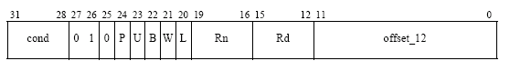
LDR Instruction
LDR rd, [rn, #offset] rd ⬅ mem[rn+offset]
rd, rn can be any register (r0 – r15)
Binary encoding of LDR/STR instruction (with immediate offset addressing mode)
distinguish between unsigned byte (1) and word (0) access
distinguish between load (1) and store (0)
add or subtract offset

Slide 54
Installing your SWI handler
Load pc method
Compute the offset to be used in the LDR instruction (at 0x08)
Take the address of the word containing the address of the new SWI handler
Subtract the address of the SWI exception vector in the vector table
Subtract 8 bytes
Check that the result can be represented in 12 bits
Logically OR this with 0xe59FF000 (the opcode for LDR pc, [pc, #0])
Store this new LDR instruction in the SWI exception vector

Slide 55
Installing your SWI Handler
Write a function that installs your SWI (exception) handler
The function will take 2 parameters
Parameter 1 – address of the memory location that stores the address of the new exception handler
Parameter 2 – a pointer to a memory location that stores the exception vector you need to change (this way you can reuse the same code for other exceptions)
The return value of this function will be the 32-bit binary encoding of the instruction currently stored at the exception vector (so that you can use the existing exception handler)

Slide 56
Loading the Vector Table (1)
Install_Handler((unsigned) location, vector);
The following code calls this function to install your SWI handler
unsigned *vector= (unsigned *) 0x08;
unsigned *location= (unsigned *) 0x210; /* The address of the new softvec */
*location= (unsigned) New_S_Handler; /* Store the address of your New_S_Handler in swiaddr */

Slide 57
Loading the Vector Table (2)
unsigned Install_Handler(unsigned location, unsigned int *vector)
/*Updates the contents of ‘vector’ stored at 0x08 to contain LDR pc, [pc, #offset] instruction to cause long branch to address in ‘location’ */
/*Function returns the original contents of ‘vector’ */
{
unsigned offset;
unsigned vec, oldvec;
offset = ((unsigned) location – (unsigned) vector – 0x8)
if(offset & 0xFFFFF000) /* check if the offset can be represented using 12 bits */
{ printf(“Installation of handler failed”);
exit(0); }
vec =(offset|0xe59FF000);/* vec now contains LDR pc, [pc, #offset] */
oldvec = *vector; /* save the old instruction at 0x08 */
*vector = vec; /* replace the contents of 0x08 with the new LDR instruction */
return(oldvec); /* return the old instruction at 0x08 for chaining */
}
vector = 0x08
*vector = 0xe59ff100
location = 0x210
vec = 0xe59ff200
*vector = 0xe59ff200
oldvec = 0xe59ff100

Slide 58
Installing the SWI Handler – Our Way
Problem: Can’t write to either the Vector Table or the “Jump” Table (both in ROM)
Solution: Overwrite the first few instructions of U-Boot’s SWI Handler
Redirect the processor to our own handler
Only eight bytes guaranteed to be available (arbitrary lab restriction)

Slide 59

Installing the SWI Handler – Our Way
Vector Table
starting at 0x00 in memory
0x00
0x04
0x08
0x0c
0x10
0x14
0x18
0x1c
B 0x850
LDR pc, [pc, 0x14]
LDR pc, [pc, 0x14]
LDR pc, [pc, 0x14]
LDR pc, [pc, 0x14]
LDR pc, [pc, 0x14]
LDR pc, [pc, 0x14]
LDR pc, [pc, 0x14]
U-Boot’s SWI Handler
(S_Handler)
Our SWI Handler
(OUR_S_Handler)
?
LDR sp, [pc, ...]
SUB sp, sp, ...
STR lr, [sp]
MRS lr, spsr
STR lr, [sp, #4]
...
“Jump” Table
0x20
0x24
0x28
0x2c
...
&U_Handler
&S_Handler
&P_Handler
&D_Handler
...

Slide 60
Installing the SWI Handler – Our Way
Which instructions to use?
Analogous situation to the SWI vector in the Vector Table
One instruction must transfer control to Our SWI Handler
Eight bytes available → four bytes for instruction, four bytes for address

Slide 61
Installing the SWI Handler – Our Way
Vector Table
starting at 0x00 in memory
0x00
0x04
0x08
0x0c
0x10
0x14
0x18
0x1c
B 0x850
LDR pc, [pc, 0x14]
LDR pc, [pc, 0x14]
LDR pc, [pc, 0x14]
LDR pc, [pc, 0x14]
LDR pc, [pc, 0x14]
LDR pc, [pc, 0x14]
LDR pc, [pc, 0x14]
U-Boot’s SWI Handler
(S_Handler)
Our SWI Handler
(OUR_S_Handler)
LDR pc, [pc, #-4]
&OUR_S_Handler
STR lr, [sp]
MRS lr, spsr
STR lr, [sp, #4]
...
“Jump” Table
0x20
0x24
0x28
0x2c
...
&U_Handler
&S_Handler
&P_Handler
&D_Handler
...

